Slide 1



Group 16 - Sample Snatchers

Slide 2

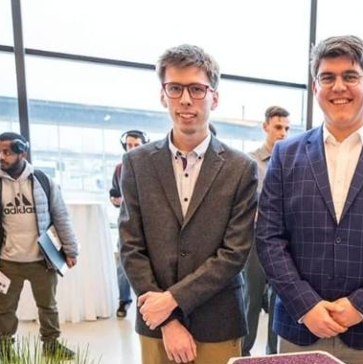
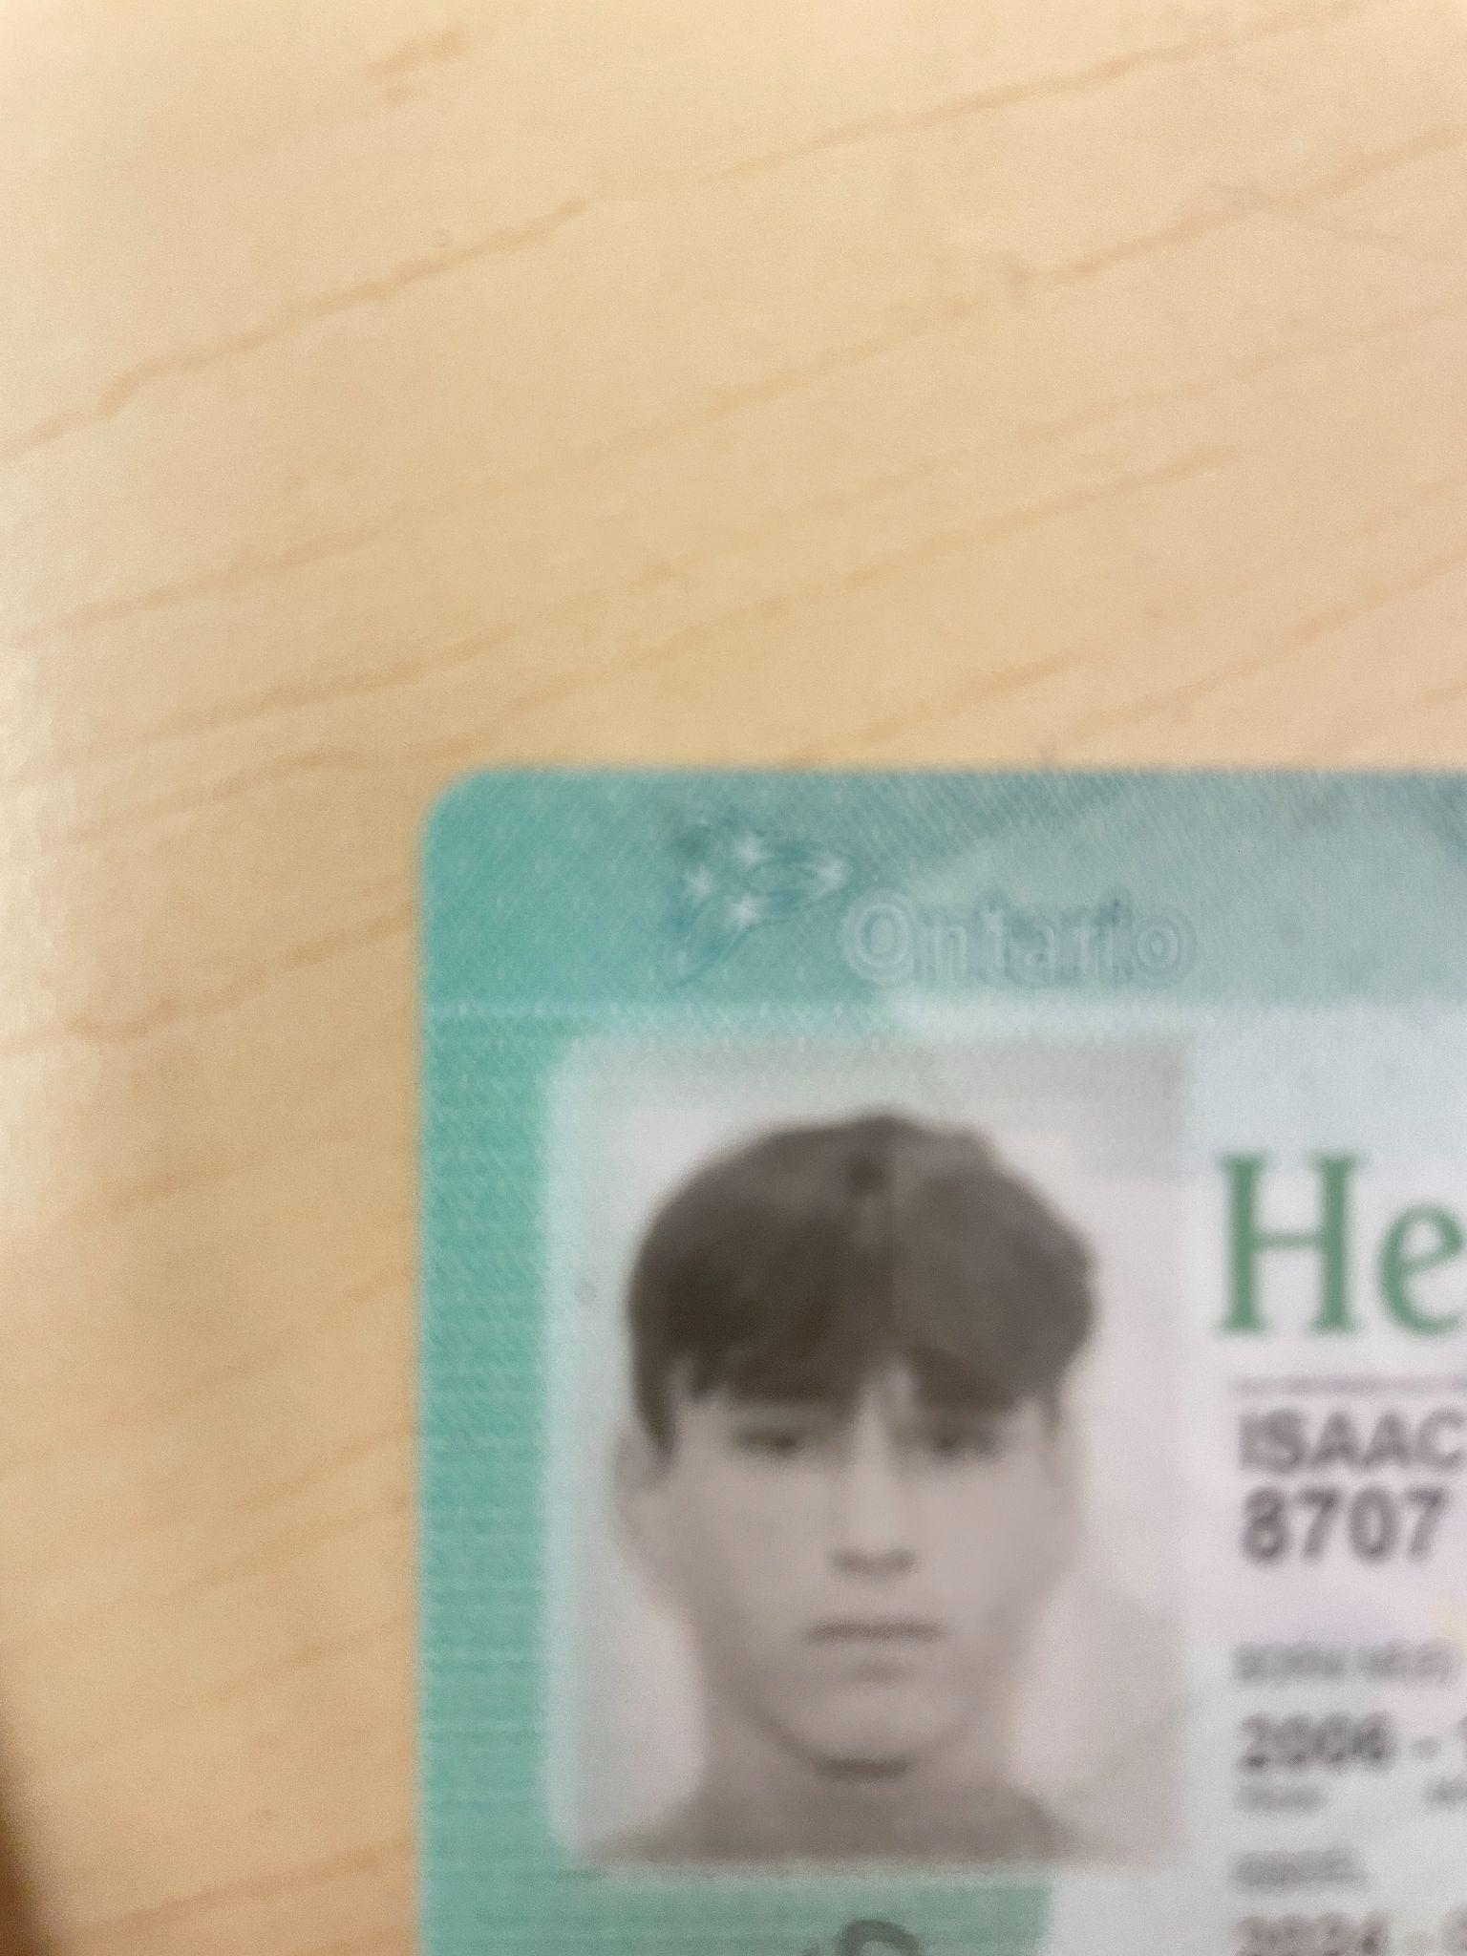
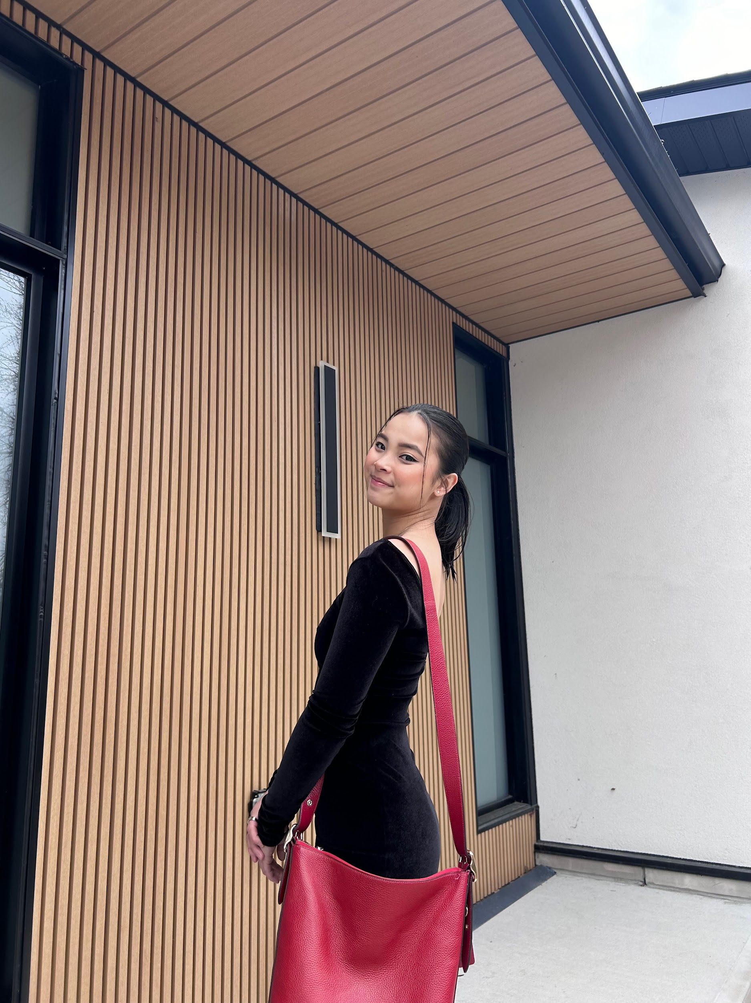

Meet the Team!
Ang Li
Tiam Morrow-Rogers
Isaac Pinarski
Eden Irwin
Radhe Pandey
Electrical Engineering
Electrical Engineering
B. Industrial Design
Civil Engineering
Chemical Engineering
Civil Engineering

Slide 3
Summary of the Project:
Objective:
Obtain a metal sample from inside a (horizontal or vertical) tube at 15 ft from the inlet of a 4 inch (ID) tube.
Problem Statement:
“Operators who service nuclear reactors need a device to collect metal samples from pressure tubes while minimizing exposure to contaminated material. The solution should be compact and completely removable from the pressure tube, and it should also be able to report the stage of operation within a limited timeframe.”

Slide 4
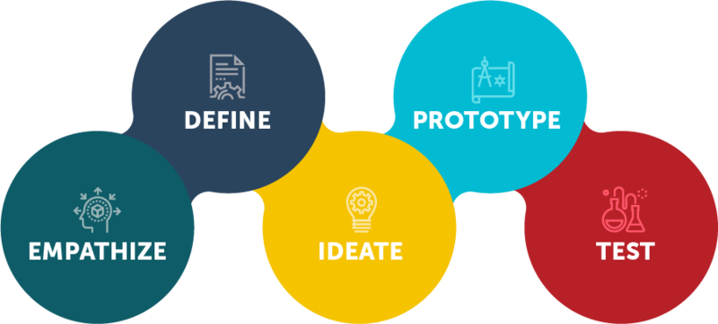
Our Approach - The Design Thinking Process

Slide 5
Empathize

Slide 6
Raw Data Collection → Interpreted Need Statements
 | User Statement | Interpreted Need
Typical Uses | To take a sample from the inside of a tube | The sample collected can be varied
 | Limits exposure to the operator | The sample is contained to limit exposure
Likes - Current Tool | All parts can be removed from the tube | The design can be completely removed
 | Can be moved around by one individual | Should be modular/lightweight
 | The device is able to be powered with available resources | Necessary power sources should be included
 | The operator is informed of the status of the machine | The design can report the current stage in its process
Dislikes - Current Tool | The client loves many things about the existing device | Is a novel creative solution
Suggestions | Russian nesting doll the sample | The sample is contained in multiple layers
 | Your device must operate within the timeframe on design day | The device is reasonably fast

Slide 7
Define

Slide 8
Hierarchy of Needs → Design Criteria
Number | Need | High Priority | Design Criteria
1 | Sample is contained to limit exposure | 🛟SAFETY🛟 | Thickness (mm) Material (Density)
2 | Design can be completely removed | 🛟SAFETY🛟 | Maneuverable
3 | The device can reach sample site 15ft in tube |  | Distance (ft)
4 | Device can fit inside pressure tube |  | Diameter (in)
5 | The sample collected can be varied |  | 30mg - 80mg sample collection
6 | The design is able to report current stage in it's process |  | Display feedback
7 | Should be modular/lightweight |  | Weight (lbs) size (cm³)
8 | Necessary power sources should be included |  | Batteries/Compressed Air/Rat
9 | Is a novel creative solution |  | Unique (by comparison)
10 | Device is reasonably fast |  | Time (s)

Slide 9
Engineering Design Specifications
Design Specifications |  | Relation (=, < or >) | Value | Units | Verification Method
 | Functional Requirements
1 | Collect a metal sample from tube wall | = | 30-80 | mg | Test
2 | Completely Removable | = | Yes | N/A | Test
3 | Enclosed Sample | = | Yes | N/A | Test
4 | Stage Reporting | = | Yes | N/A | Test
5 | Visual for process | = | Yes | in, dpi | Test
6 | Device speed | < | 7 | min | Test
7 | Power source included | = | Yes | N/A | Analysis
8 | Distance Traveled | = | 15 | ft | Test
Design Specifications |  | Relation (=, < or >) | Value | Units | Verification Method
 | Non-Functional Requirements
1 | Aesthetics | = | Yes | N/A | Survey
2 | Safety | = | Yes | N/A | Analysis
3 | Corrosion Resistant | = | Yes | N/A | Analysis
4 | Operation Time | < | 10 | mins | Test
5 | Creative Solution | = | Yes | N/A | Analysis
Design Specifications |  | Relation (=, < or >) | Value | Units | Verification Method
 | Constraints
1 | Weight | < | 2 | kg | Analysis
2 | Size (Diameter) | < | 4 | in | Analysis
3 | Size (Length) | < | 4 | ft | Analysis
4 | Sample Exposure | < | Yes | N/A | Test
5 | Sample Collection | = | 30 - 80 | mg | Test

Slide 10
Benchmarking
Device Specifications ⬇️ | Device ➡️ | CWEST | Arterial Catheter | Drain Snake | CSA420 Endress | Mars Rover - Curiosity
Company |  | Kinectrics | Generic | Generic | Endress & Hauser | NASA
Cost |  | $$$$$$$$$$ | $ | $ | $$$ | $$$$$$$$$$$$$
Stability |  | BRIMs | Guided by artery | None | Manual | Multiple surface contact points
Shape |  | Tube | Wire | Wire | Tube | Rectangular
Power |  | External: BRIMs | N/A | External: Man power | External: Man power | Solar + Radioisotope
Failsafe |  | BRIMs | Pressure Drop | None | None | Safe-mode software, sensors
Controls |  | BRIMs | Direct hand | Direct Hand | Control panel | Digital signalling
Sampling Method |  | Scraping | Suction | Friction | Water Pressure | Drill, Scoop
Size |  | ~4 ft | 20 gauge | 35.5” x 0.45” | 381 mm x 75 mm | 10’ x 9’7” x 7’
Sample Size |  | 30-80mg | 1 mL | N/A | Liquid | 45mm³
Material |  | Zirconium | Polyurethane, Silicone, Nitinol, Stainless Steel | plastic, metal | Polyamide PA, Stainless Steel | 7075 Aluminum, Titanium. Aerogel

Slide 11
Ideate

Slide 12
Subsystems
Subsystem 1: Movement - Navigating to and from the sample site inside the fifteen-feet tube.
Subsystem 2: Sampling - The method in which sampling is conducted.
Subsystem 3: Containment - Ensuring the sampled material doesn’t contact the operator.
Subsystem 4: Failsafe - The ability to retrieve the entire device from the tube.

Slide 13
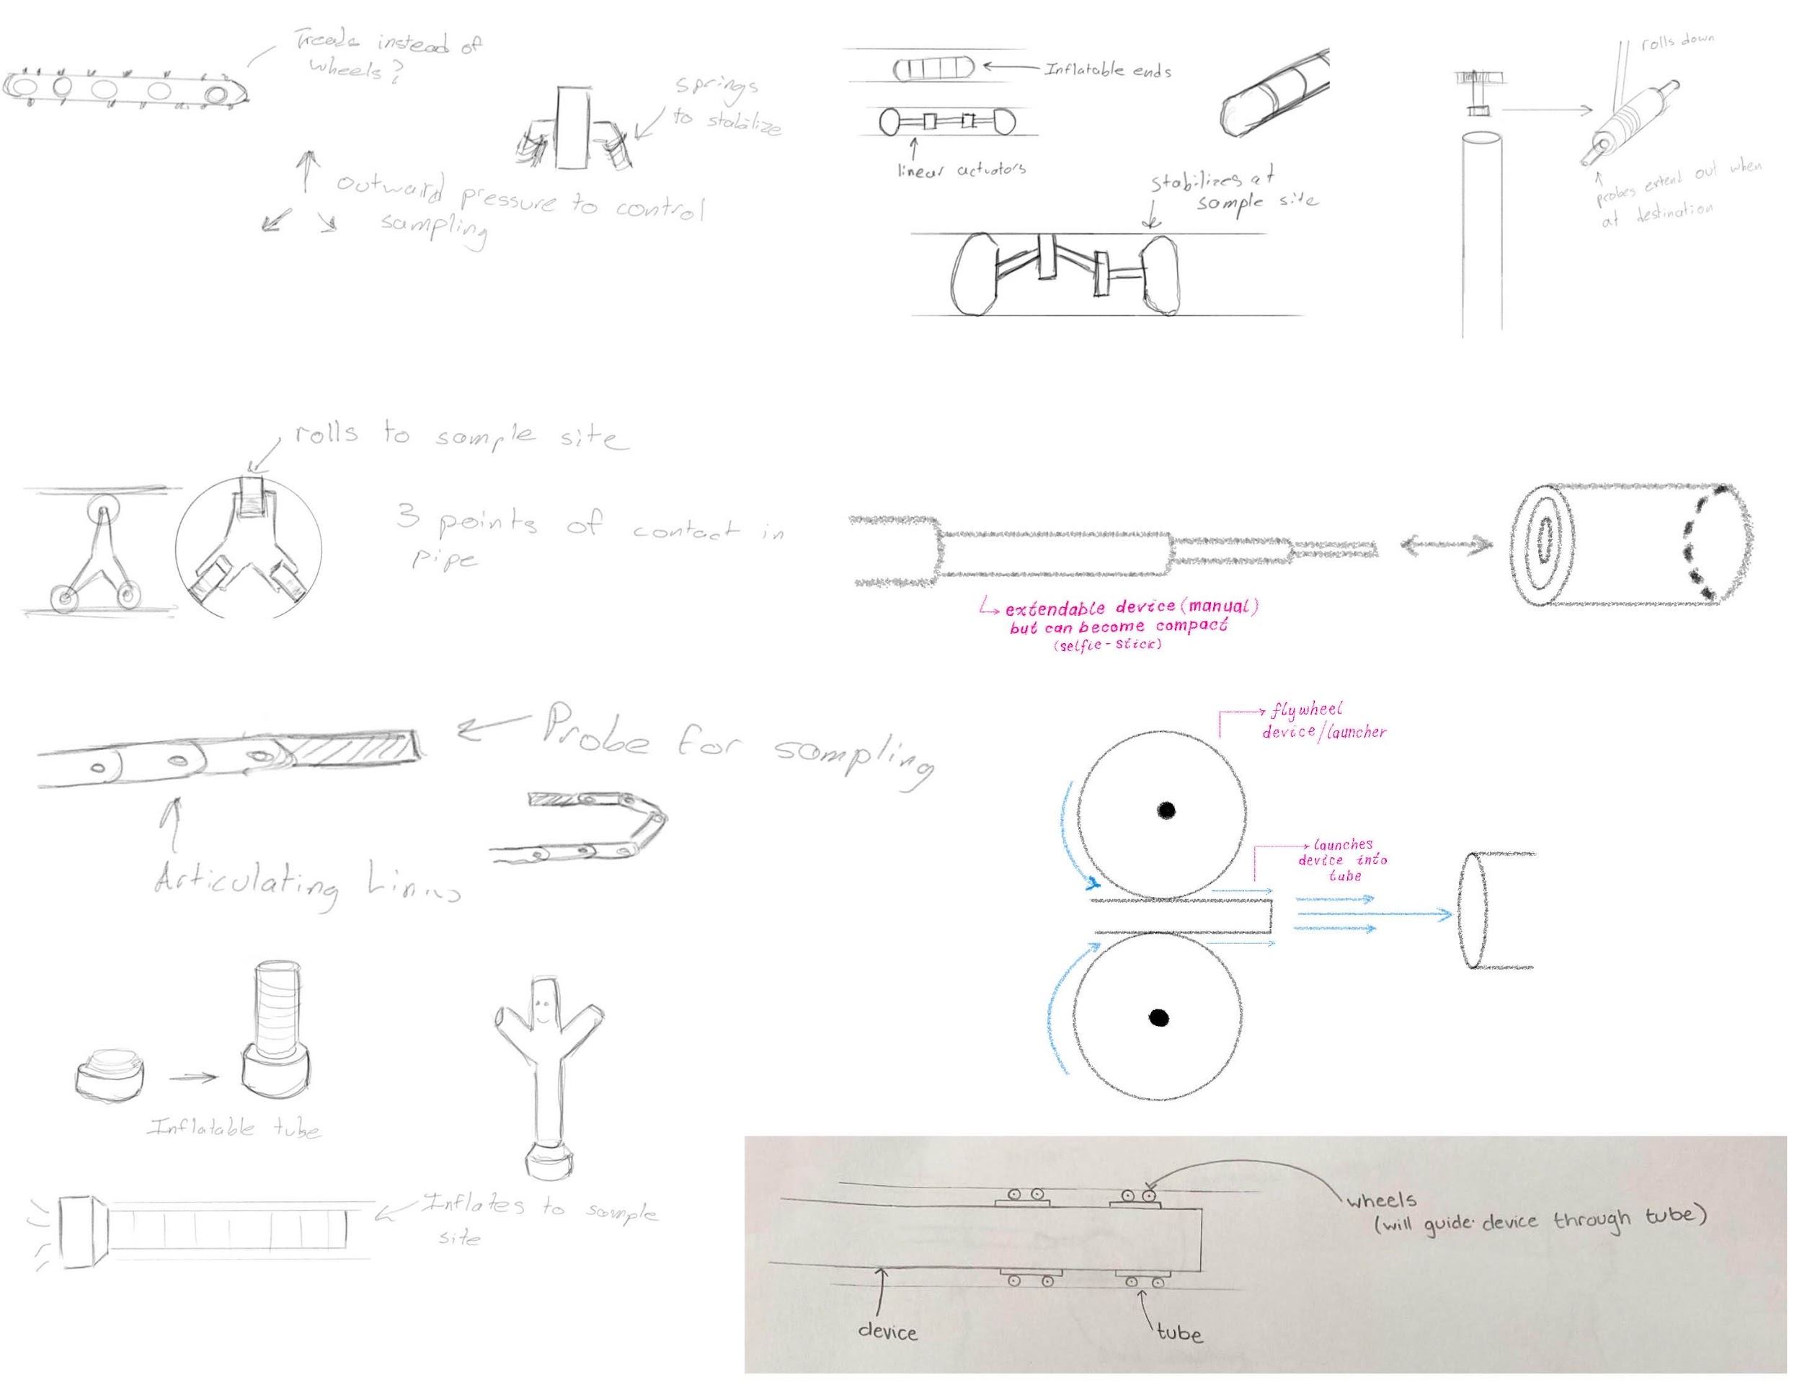

Slide 14
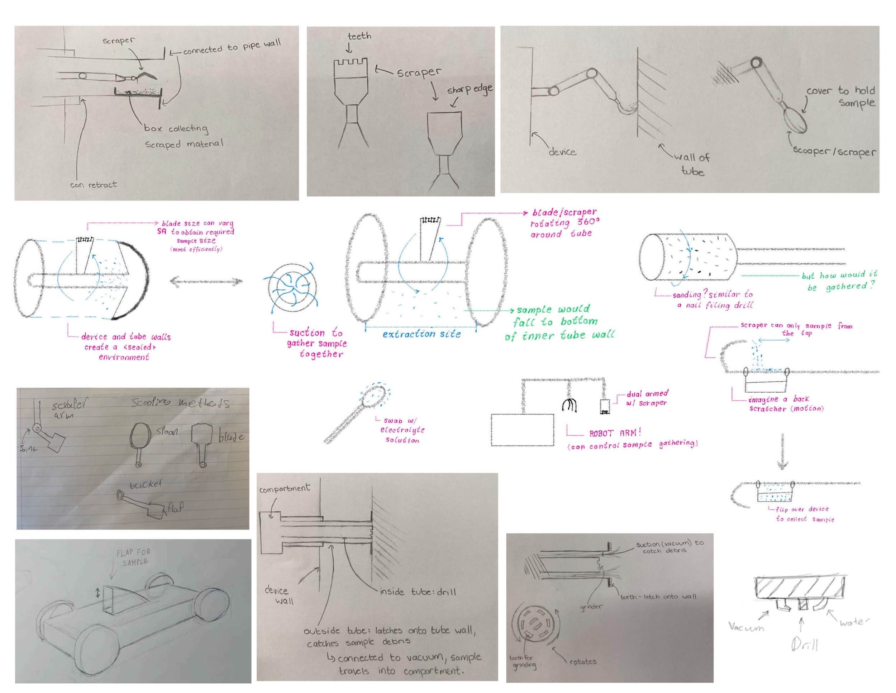

Slide 15
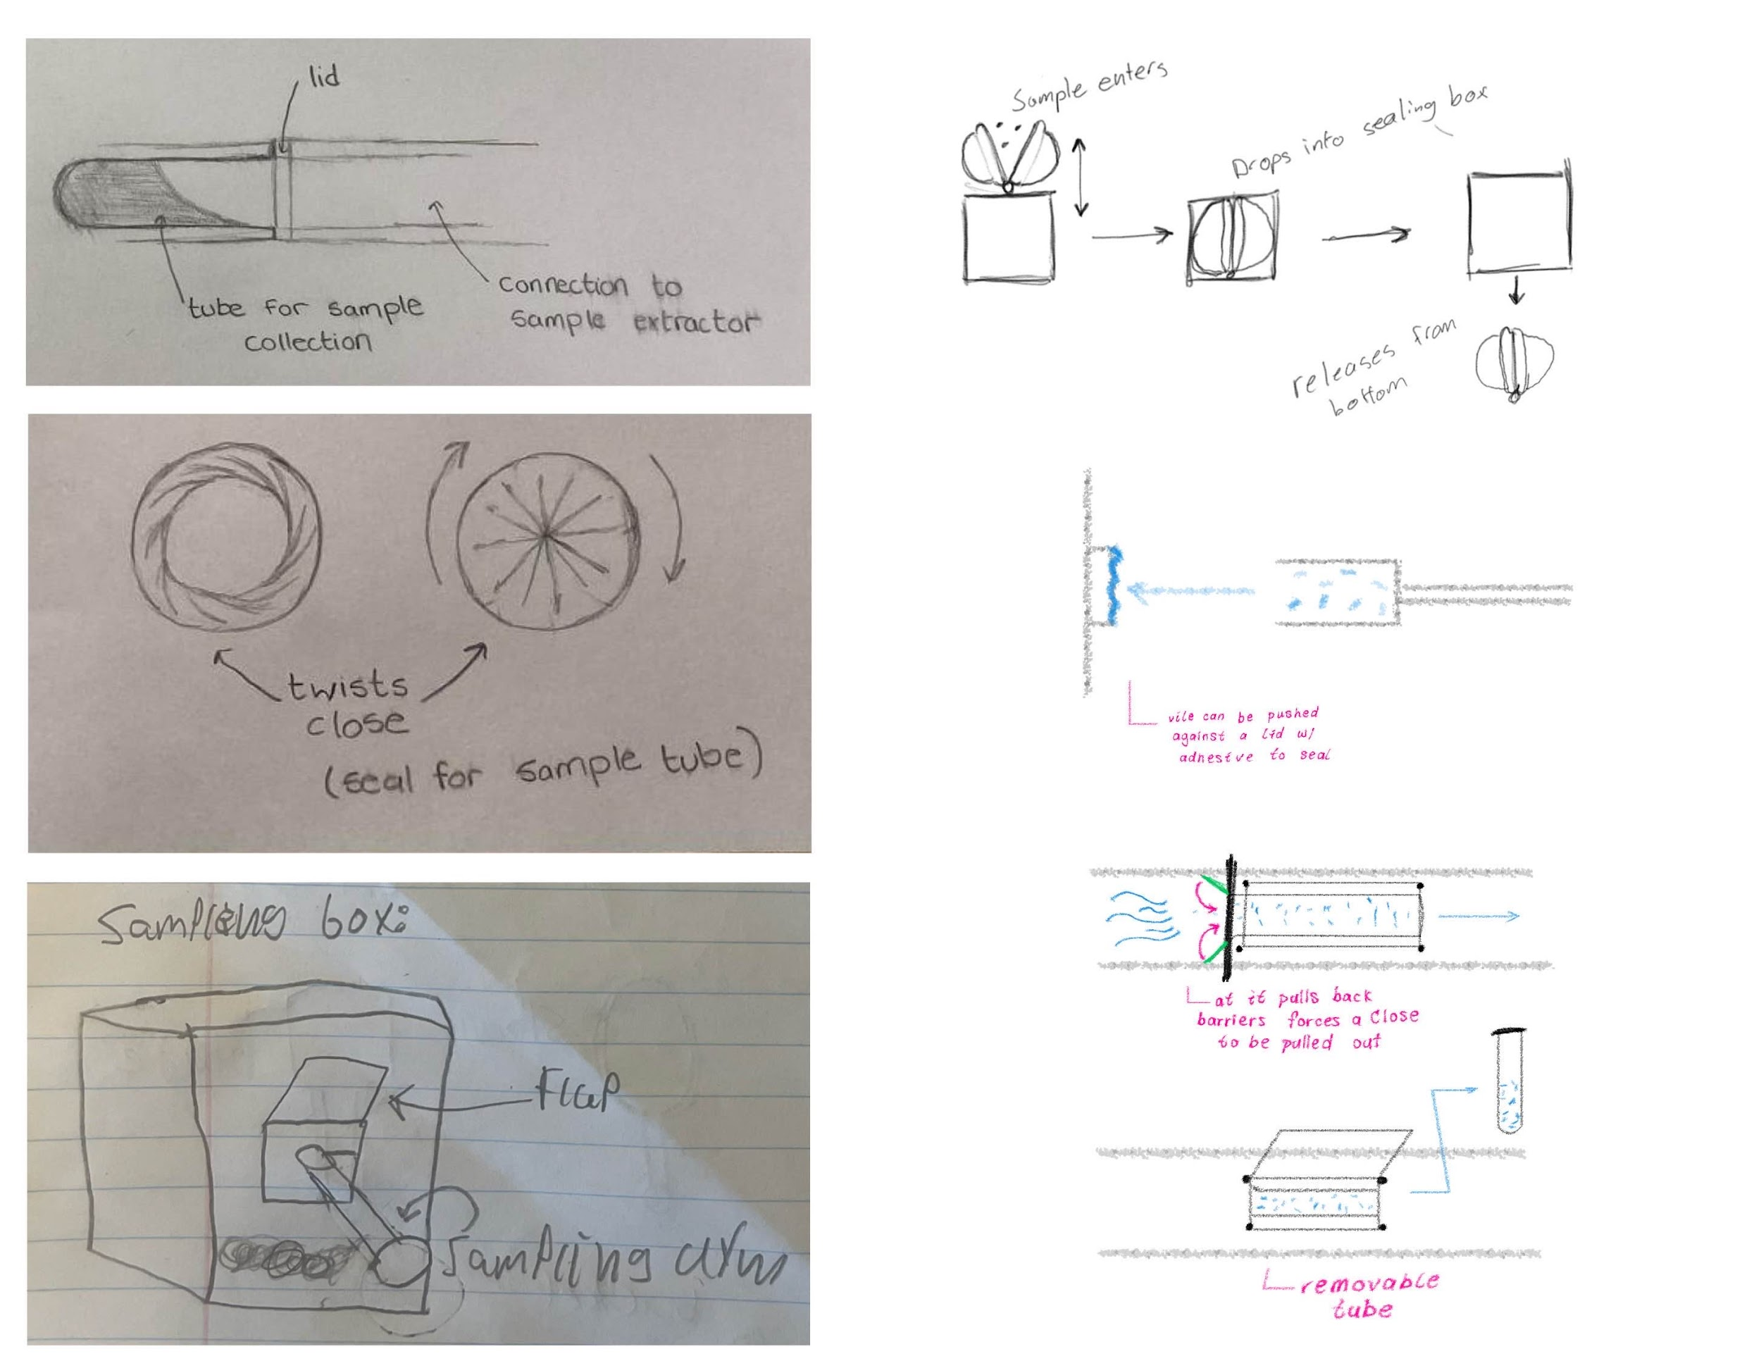

Slide 16
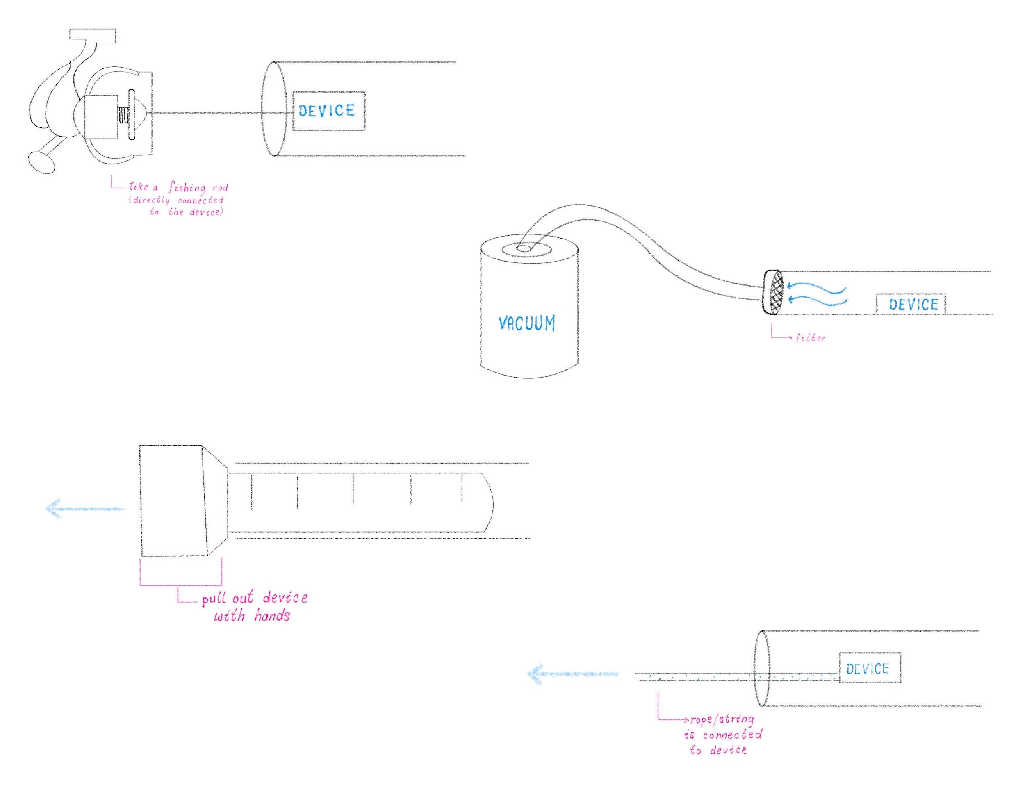

Slide 17
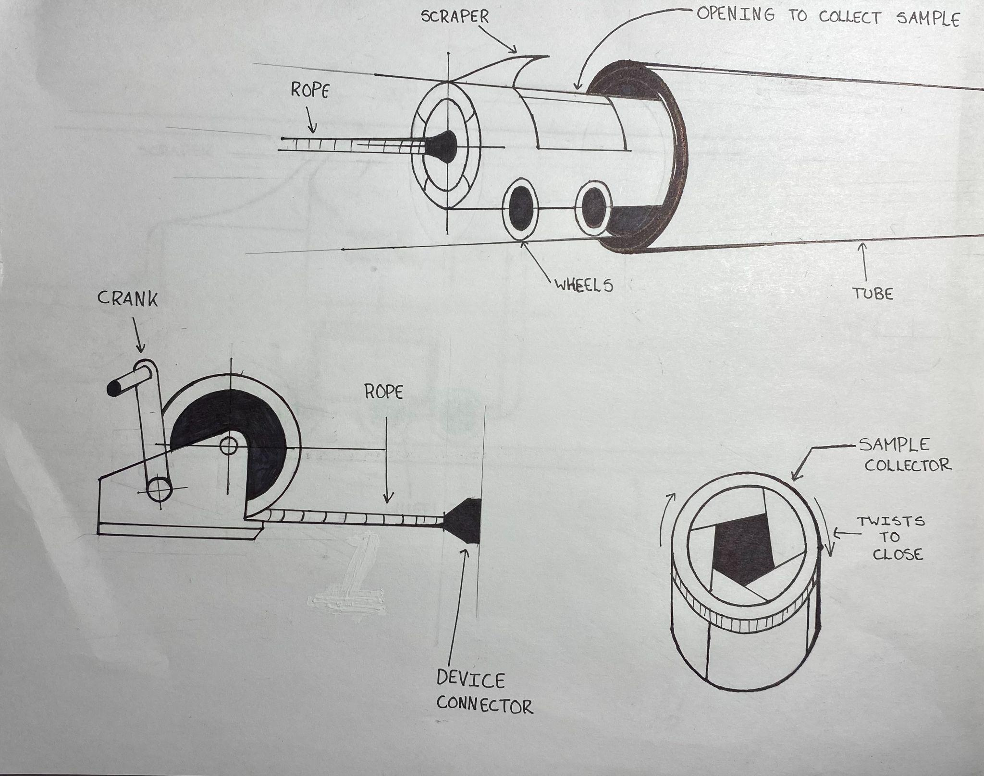
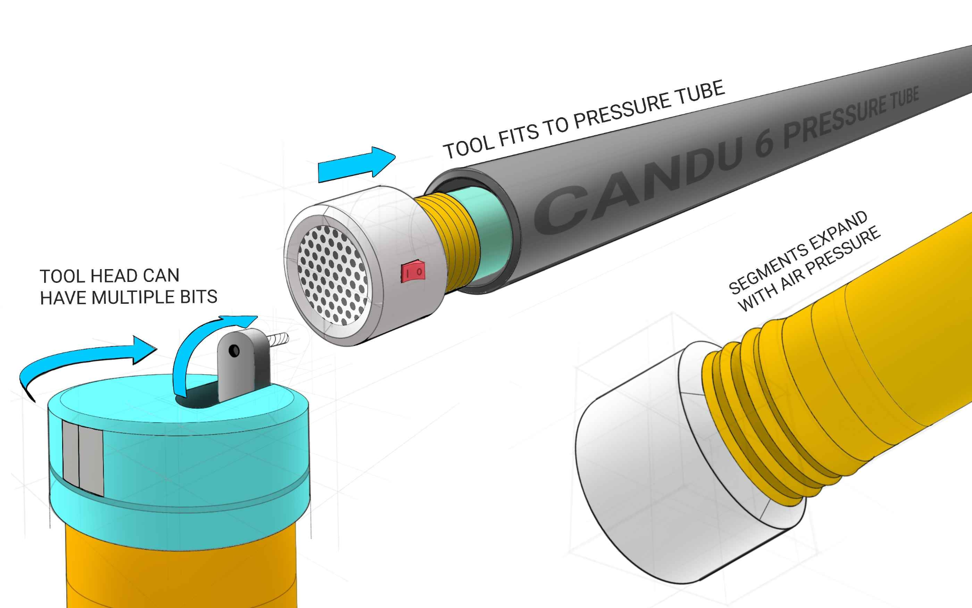
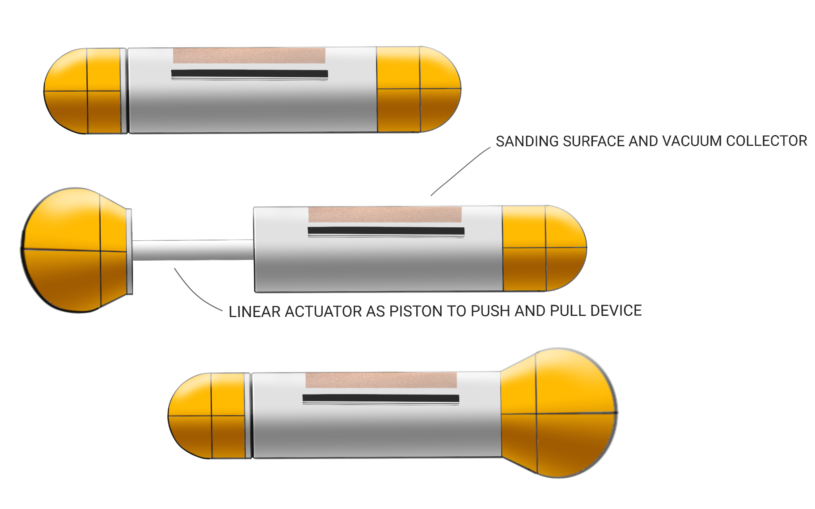
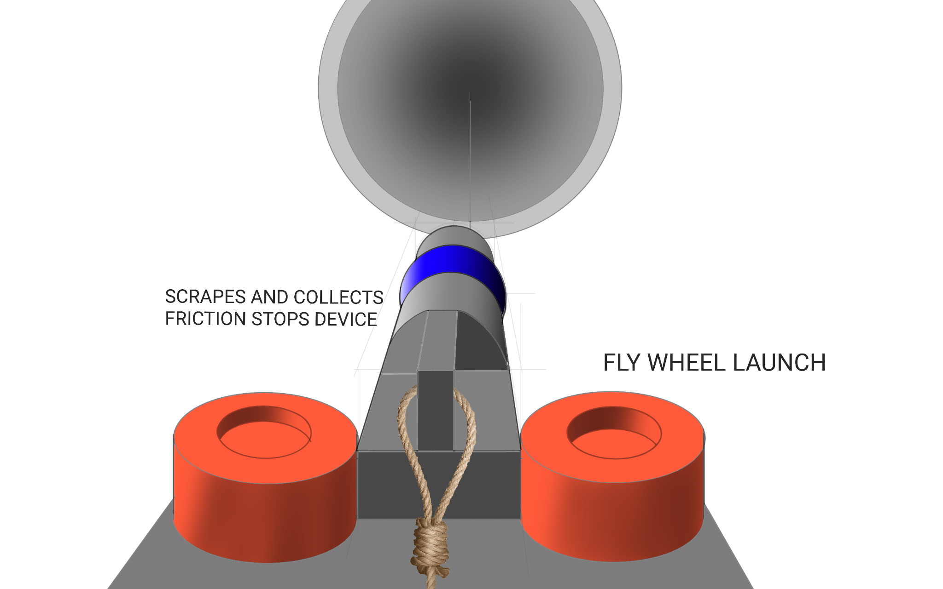
Developed Concepts
1
3
2
4

Slide 18
Ideate - Evaluation of Concepts
Concept Number → | Concept 1 |  |  | Concept 2 | Concept 3 | Concept 4
Design Criteria ↓
Containment | Easy to implement a controllable solution |  |  | The sanding pad would be highly contaminated | The multi-tool head could implement a better subsystem | The flap could break off
Removable | Dependent on reel in the event of motor failure or power loss |  |  | Could get stuck | The air pump can be run in reverse to pull the inflatable back in | High risk of damage or loose parts
Modular/Lightweight | Depends on materials. |  |  | Depends on materials. | The device packs down small | The launcher may be heavy
Creative Solution | It’s a drone. |  |  | Is a creative solution (via inchworm) | Is a creative solution (via an inflatable tube) | Is a creative solution (via flywheel launcher)
Reasonably Fast | Motors provide good speed and torque |  |  | Many steps for movement slow down speed | Inflates faster than a twin-size air mattress | Very high-speed launch
Fits Inside Tube | Need to consider motor size |  |  | It might not be able to be sized appropriately | Powered components can be outside tube | Can launch a smaller device
Complexity | Many resources for similar designs |  |  | It has a lot of mechanical operations for a single action | Combining the functions of all components. | Combining the functions of all components.
TOTAL | 16 |  |  | 11 | 19 | 15

Slide 19
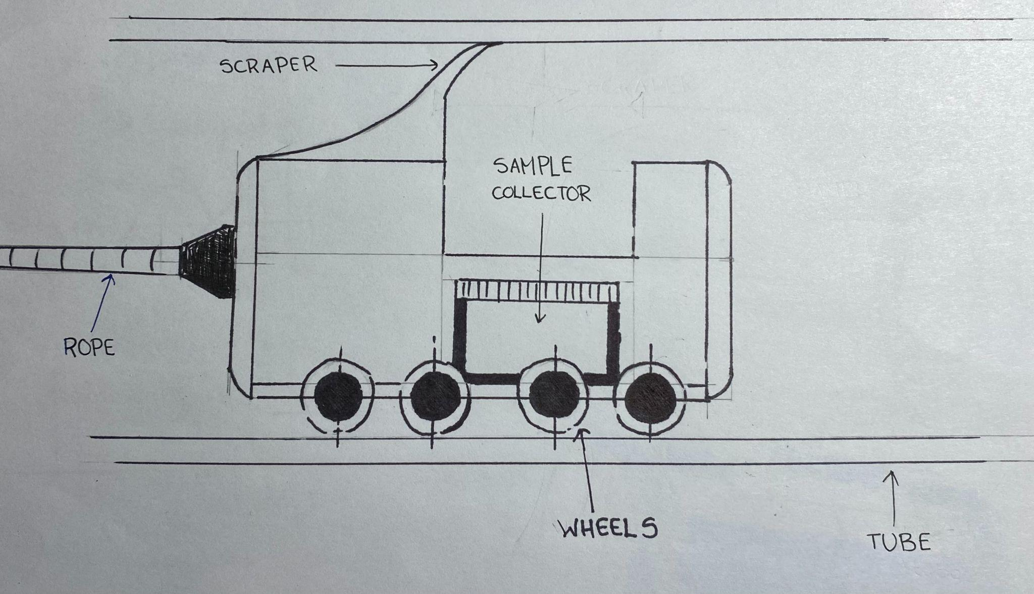
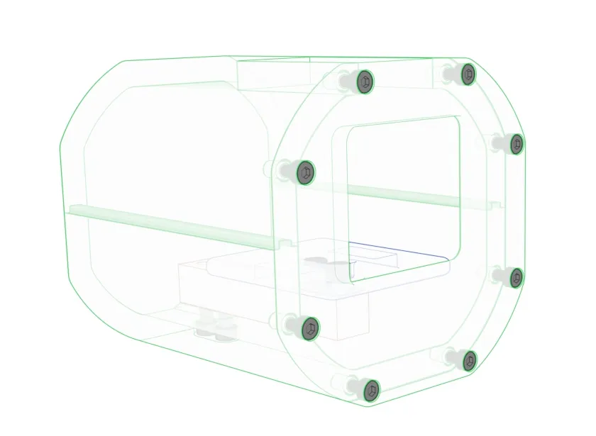
Selected Concept
The
Sample Subway

Slide 20
Prototype & Test

Slide 21
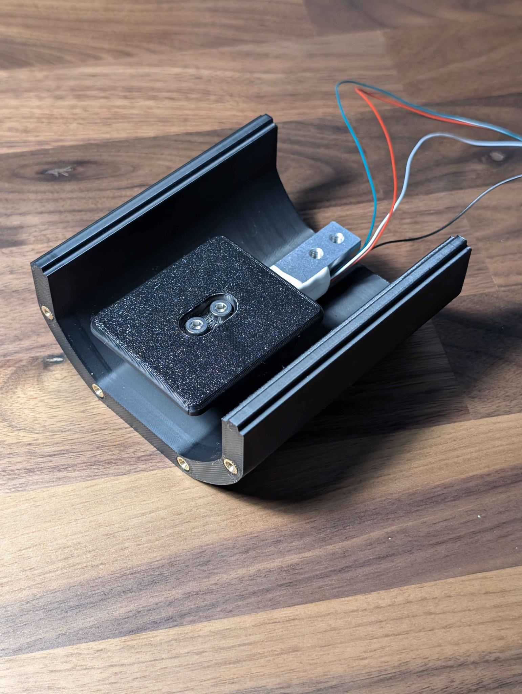
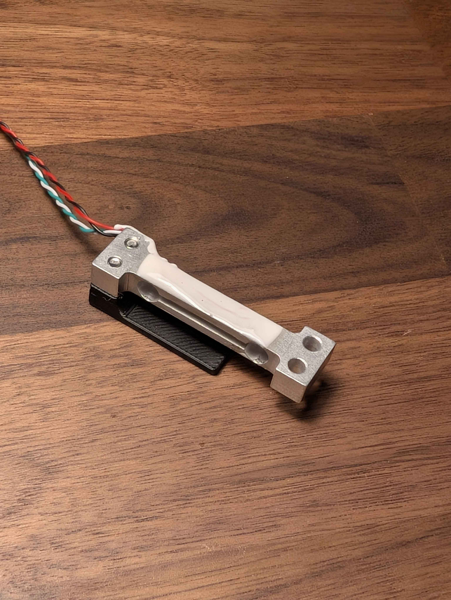
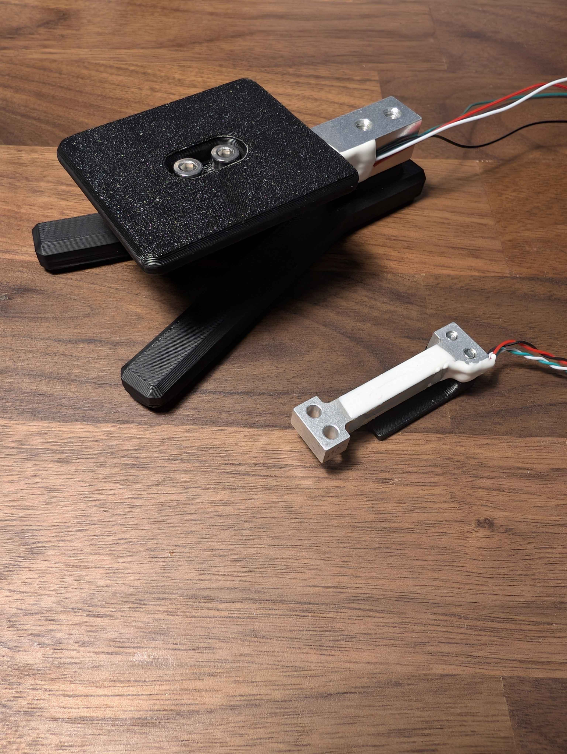
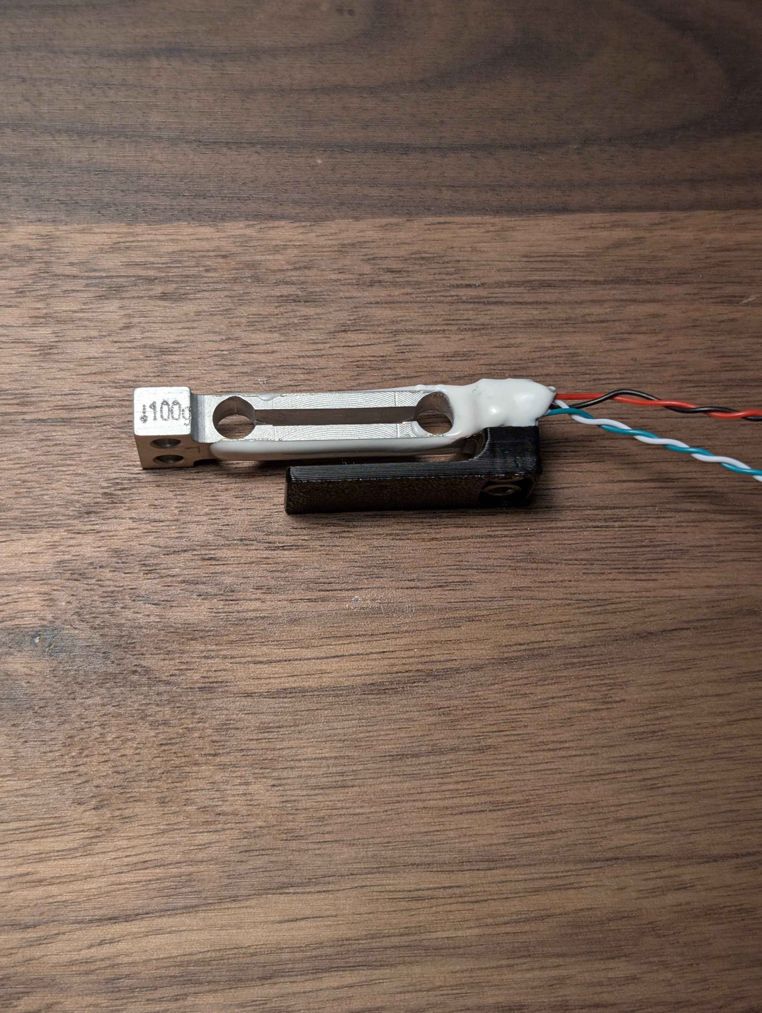



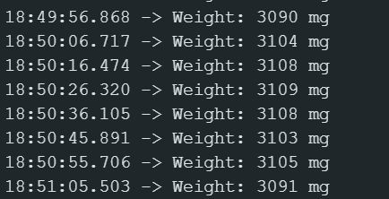
Prototype I - Measurement Mechanism

Slide 22
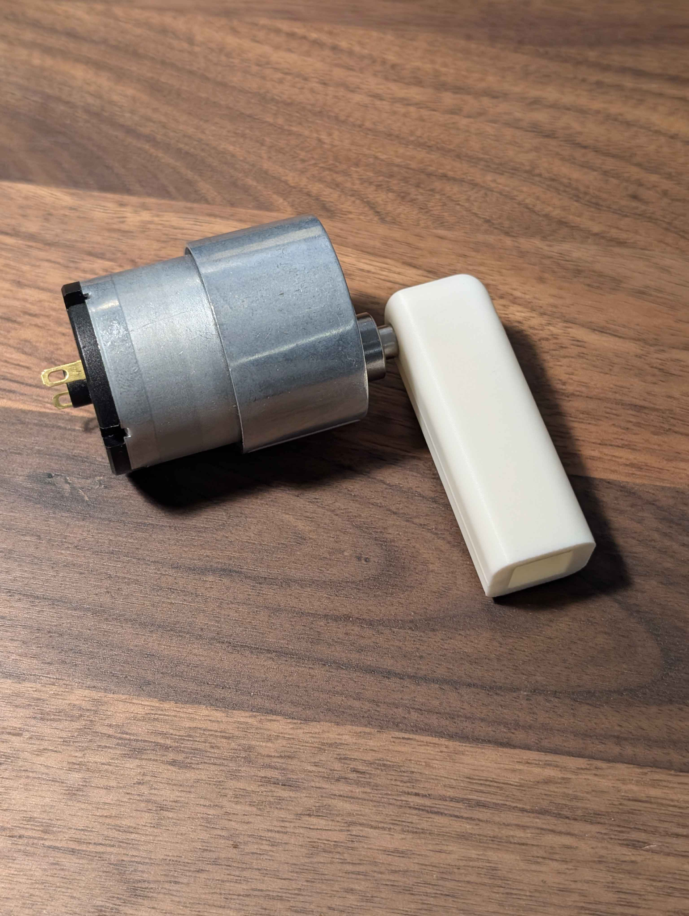
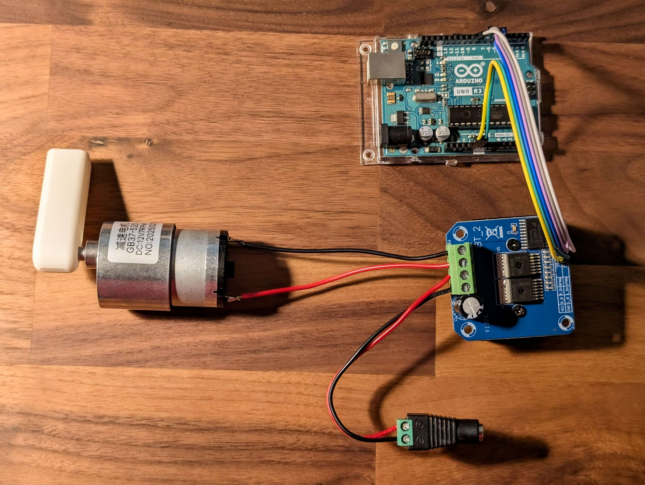
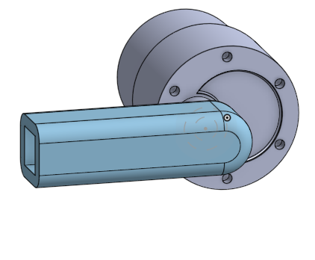
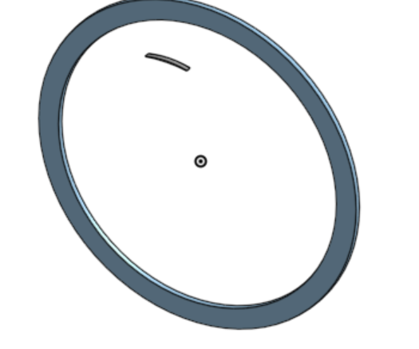
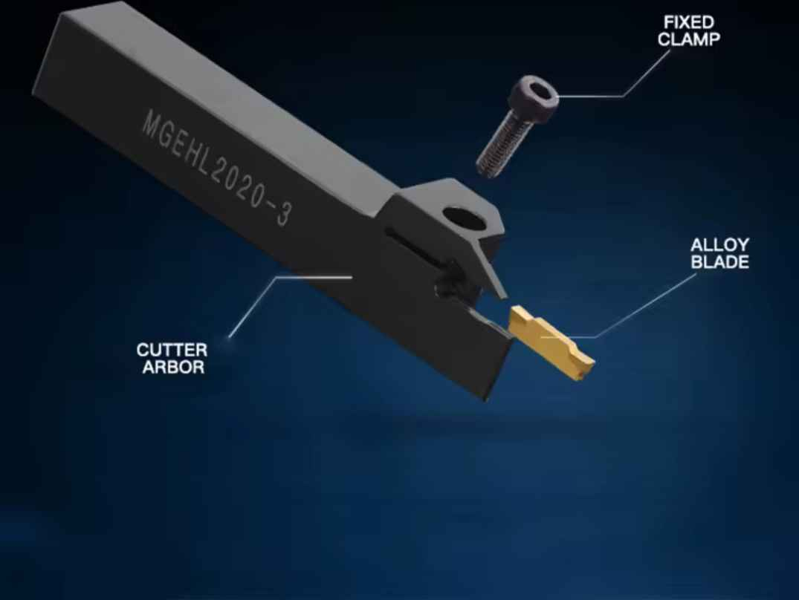
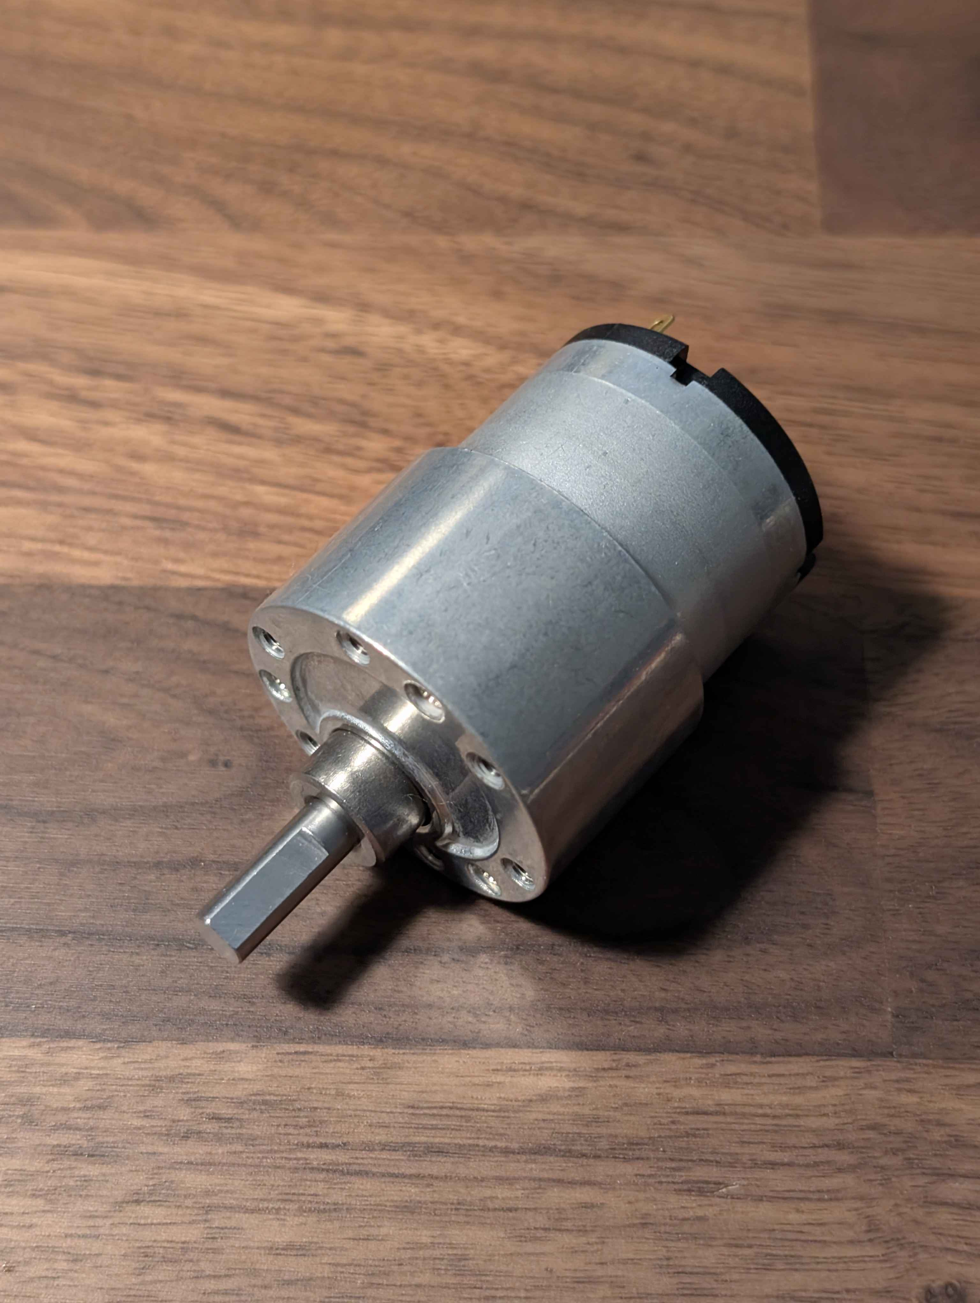
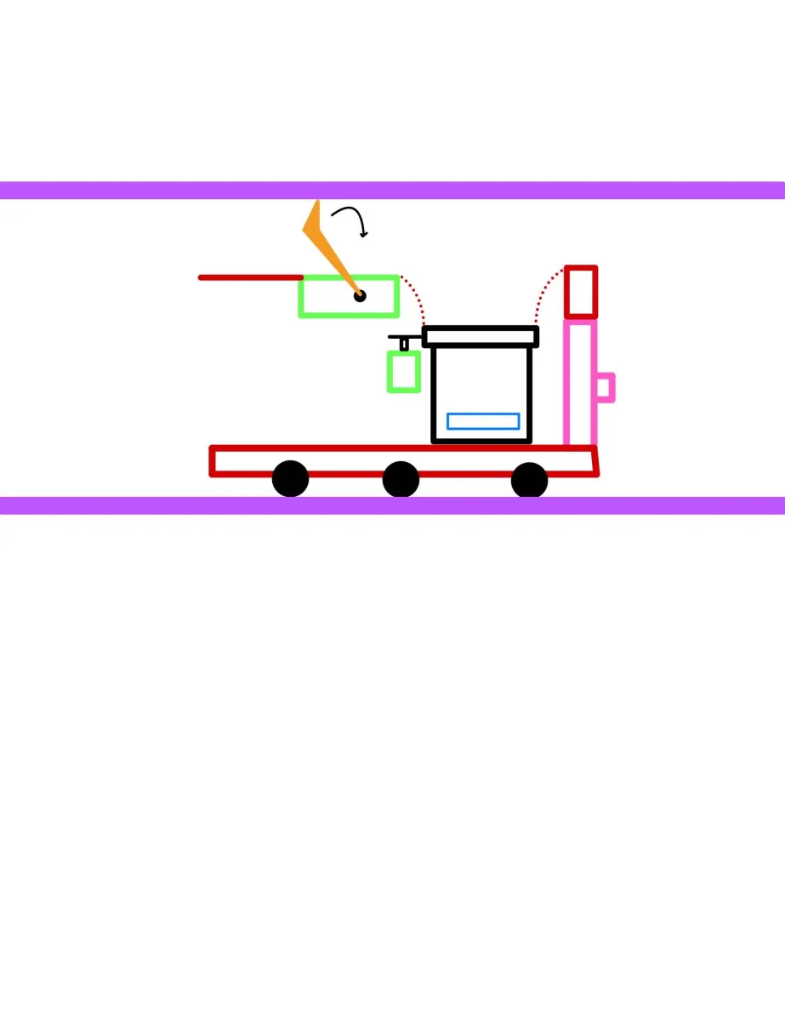
Prototype II - Sampling Mechanism
 | Motors
 | Scraping Bit
 | Load Cell

Slide 23
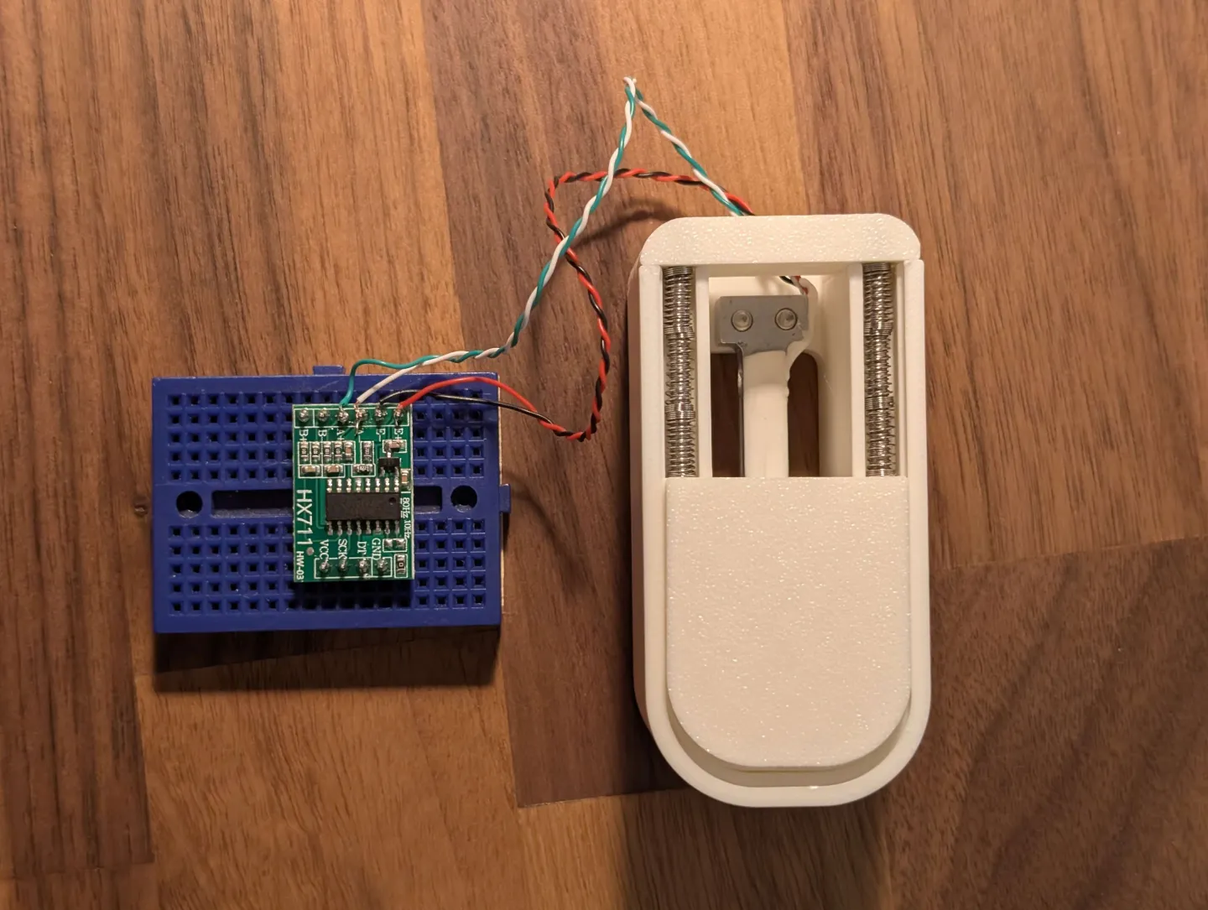
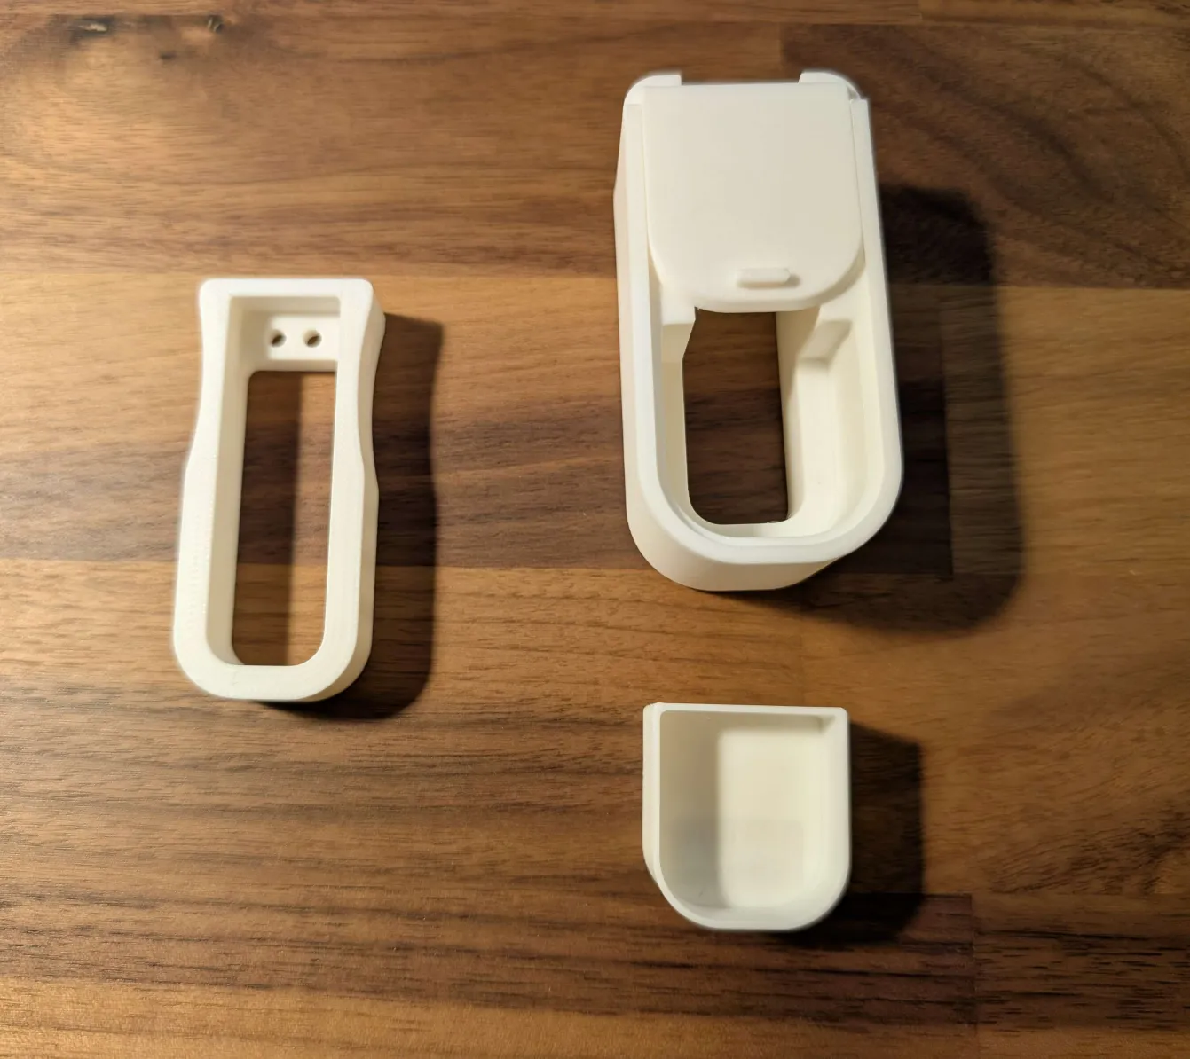
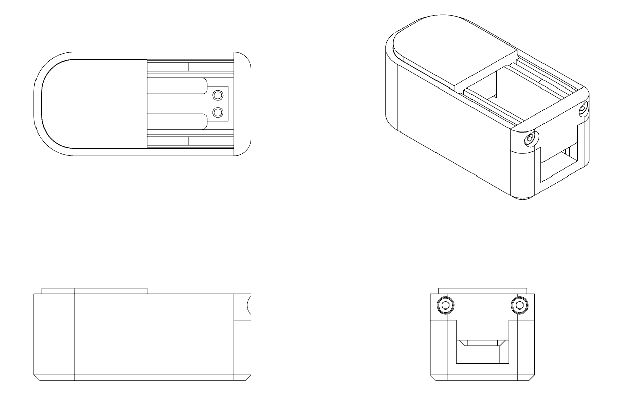
Prototype III - Containment Mechanism
3D Print Prototypes
CAD Model

Slide 24
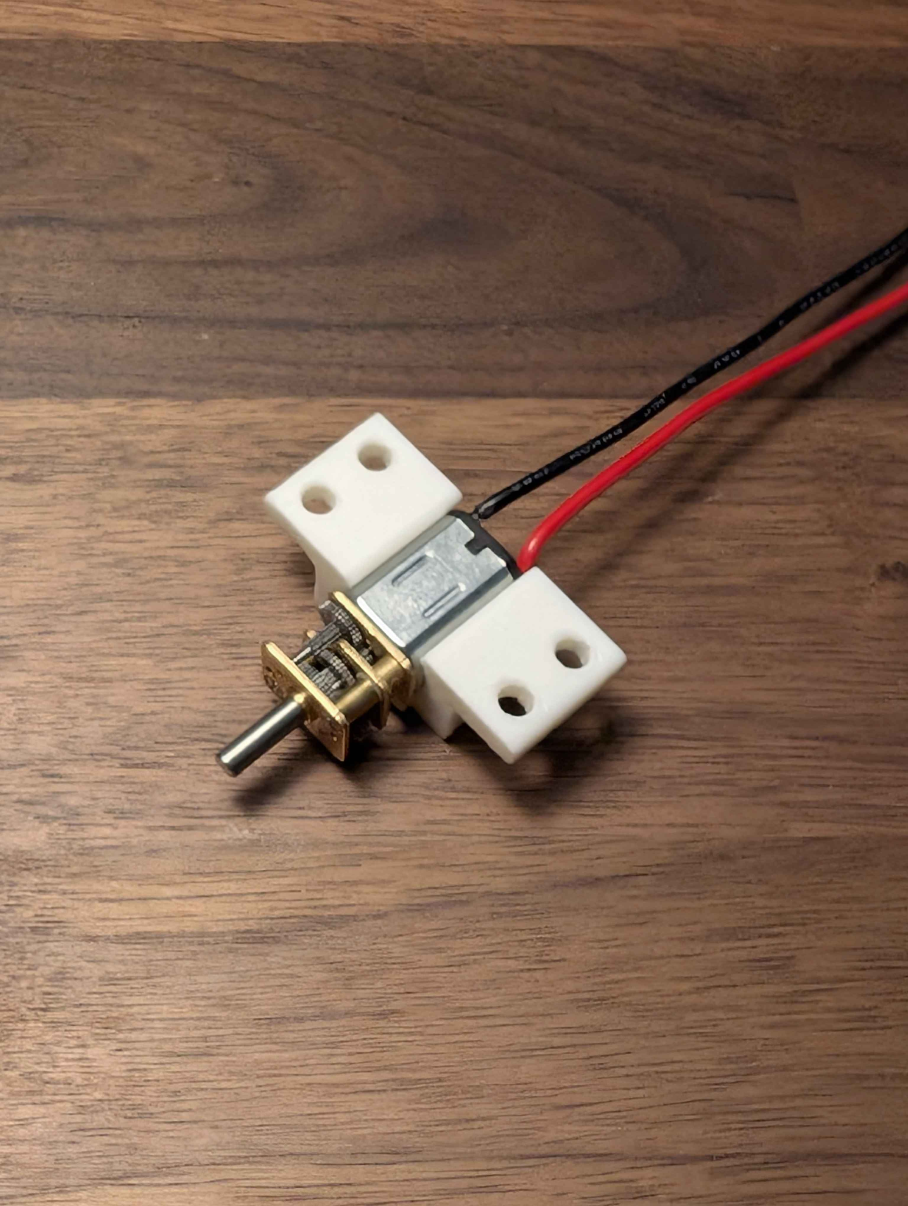
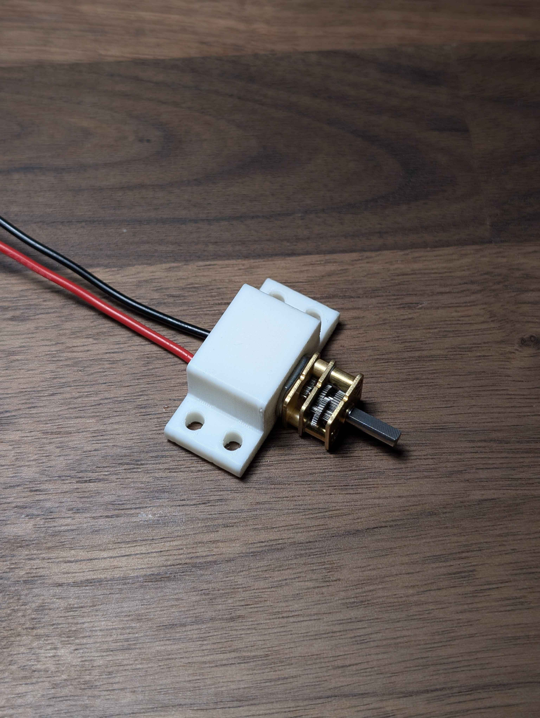
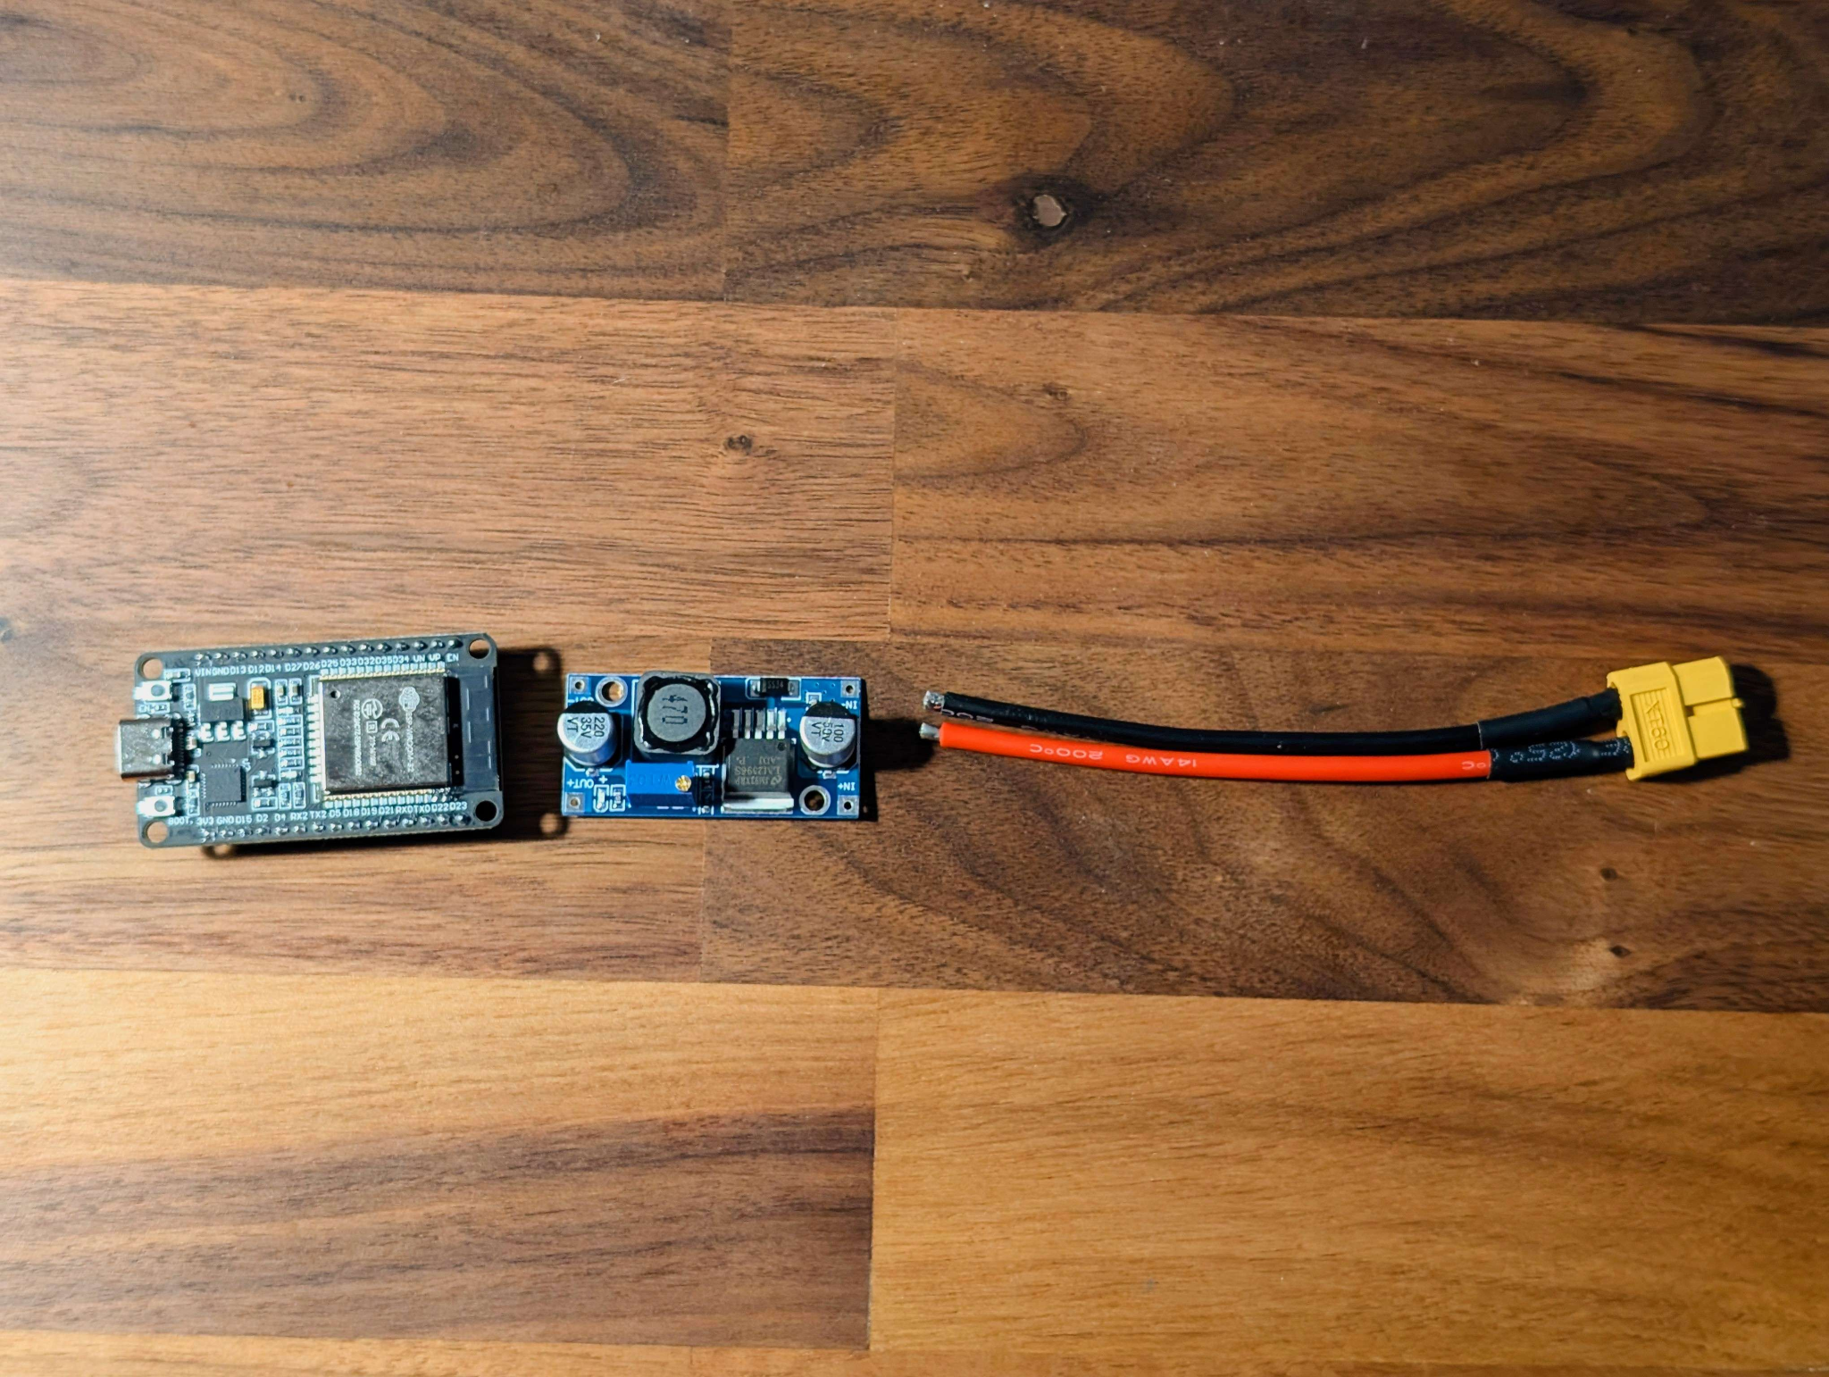
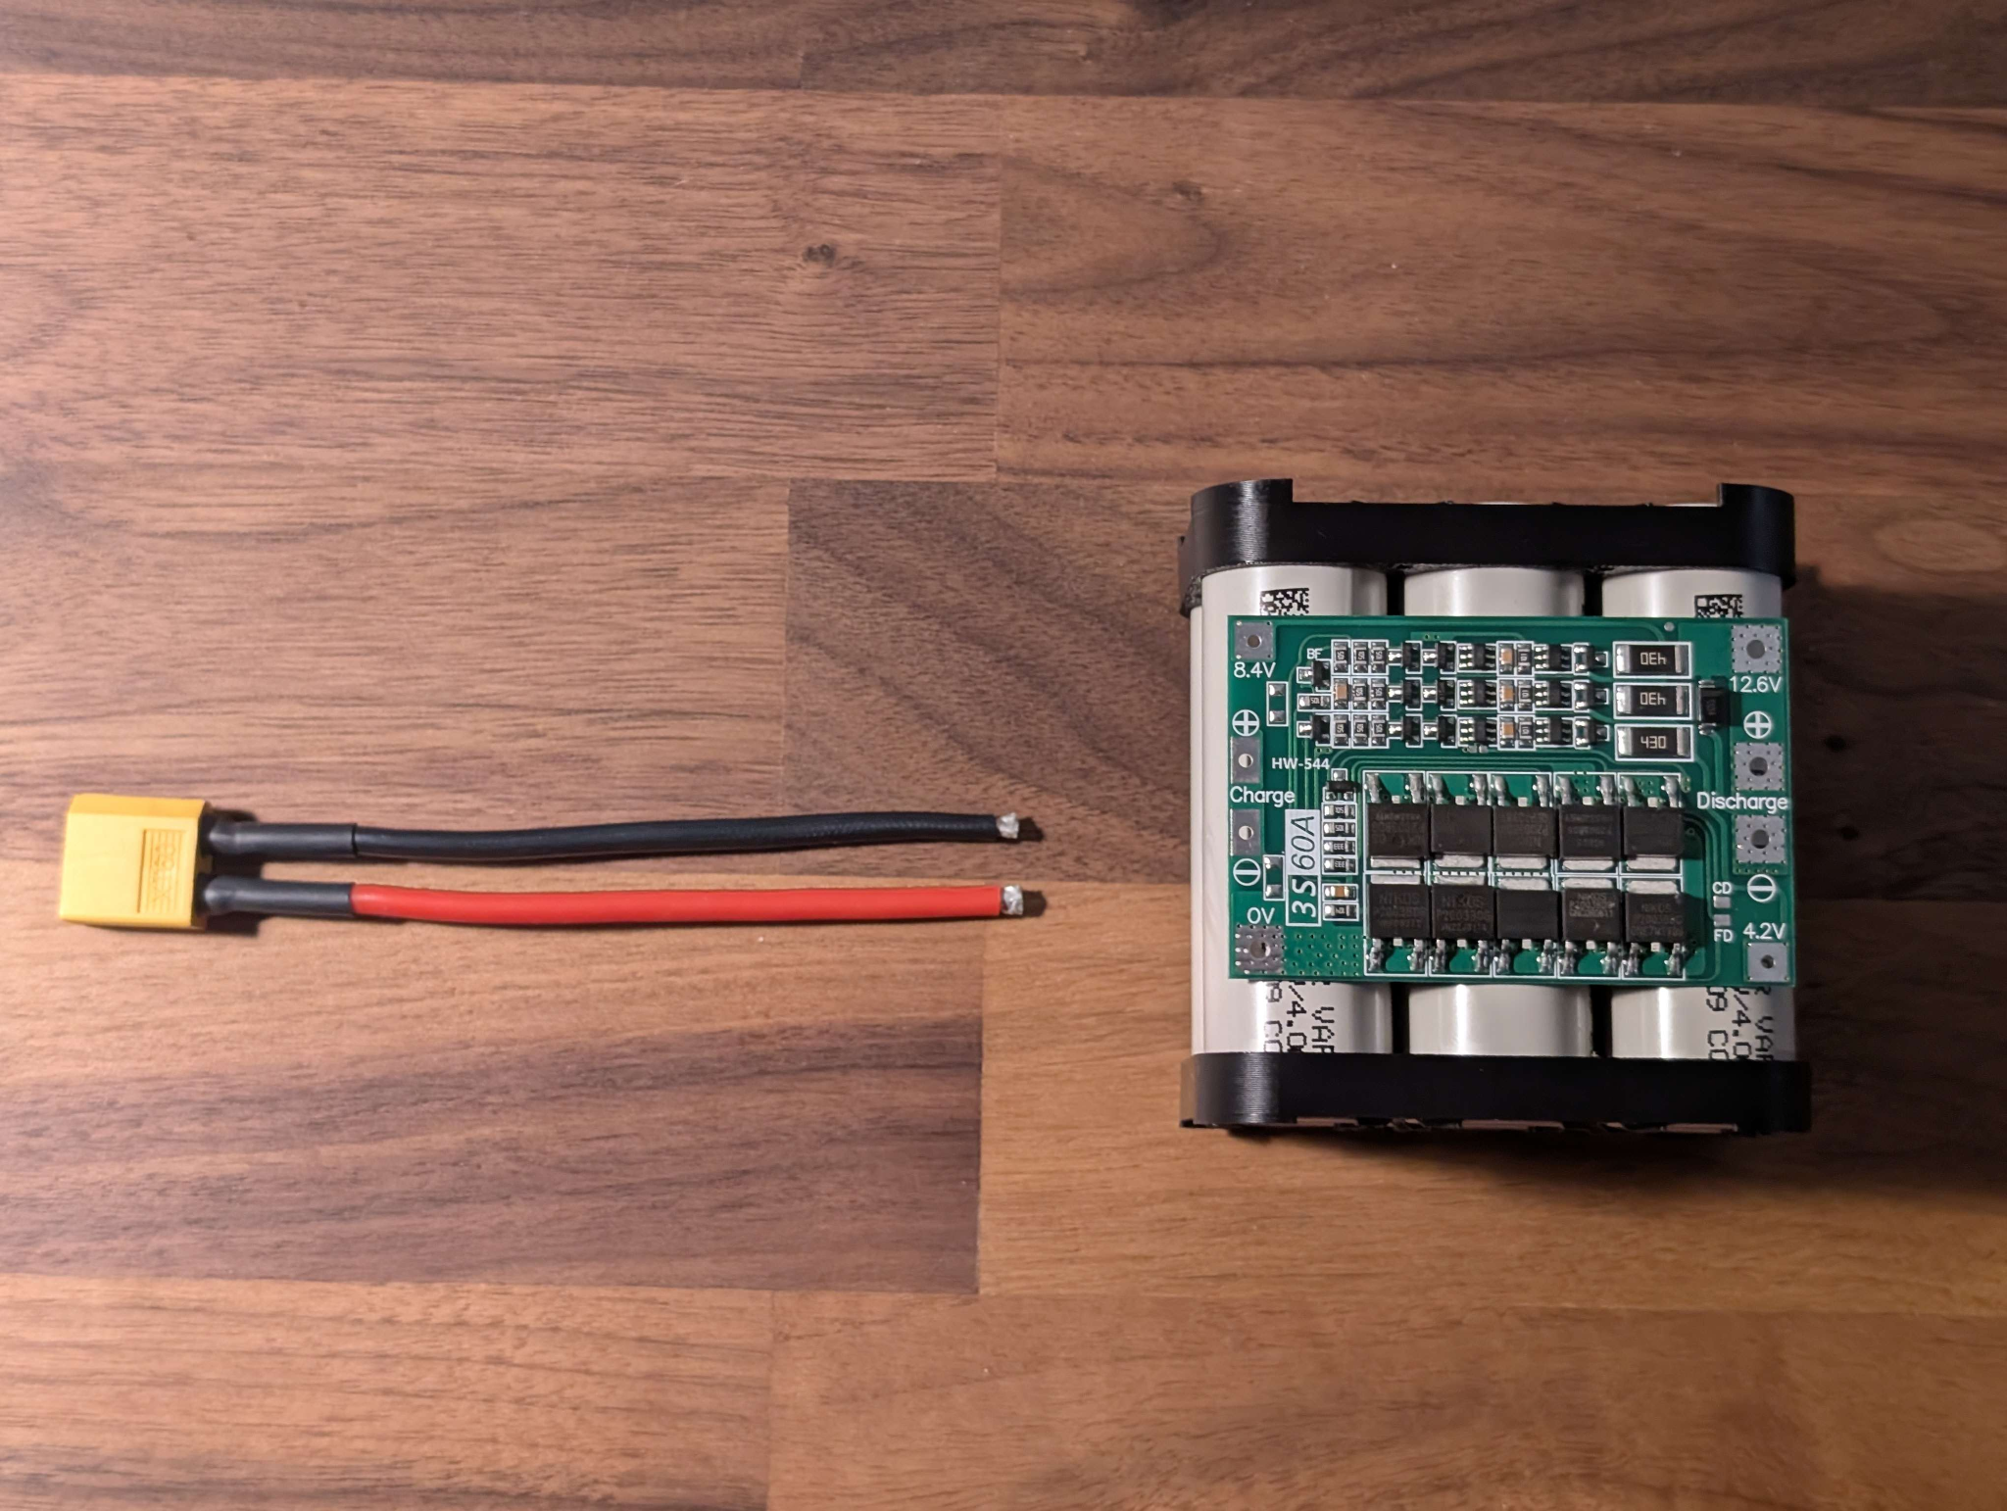
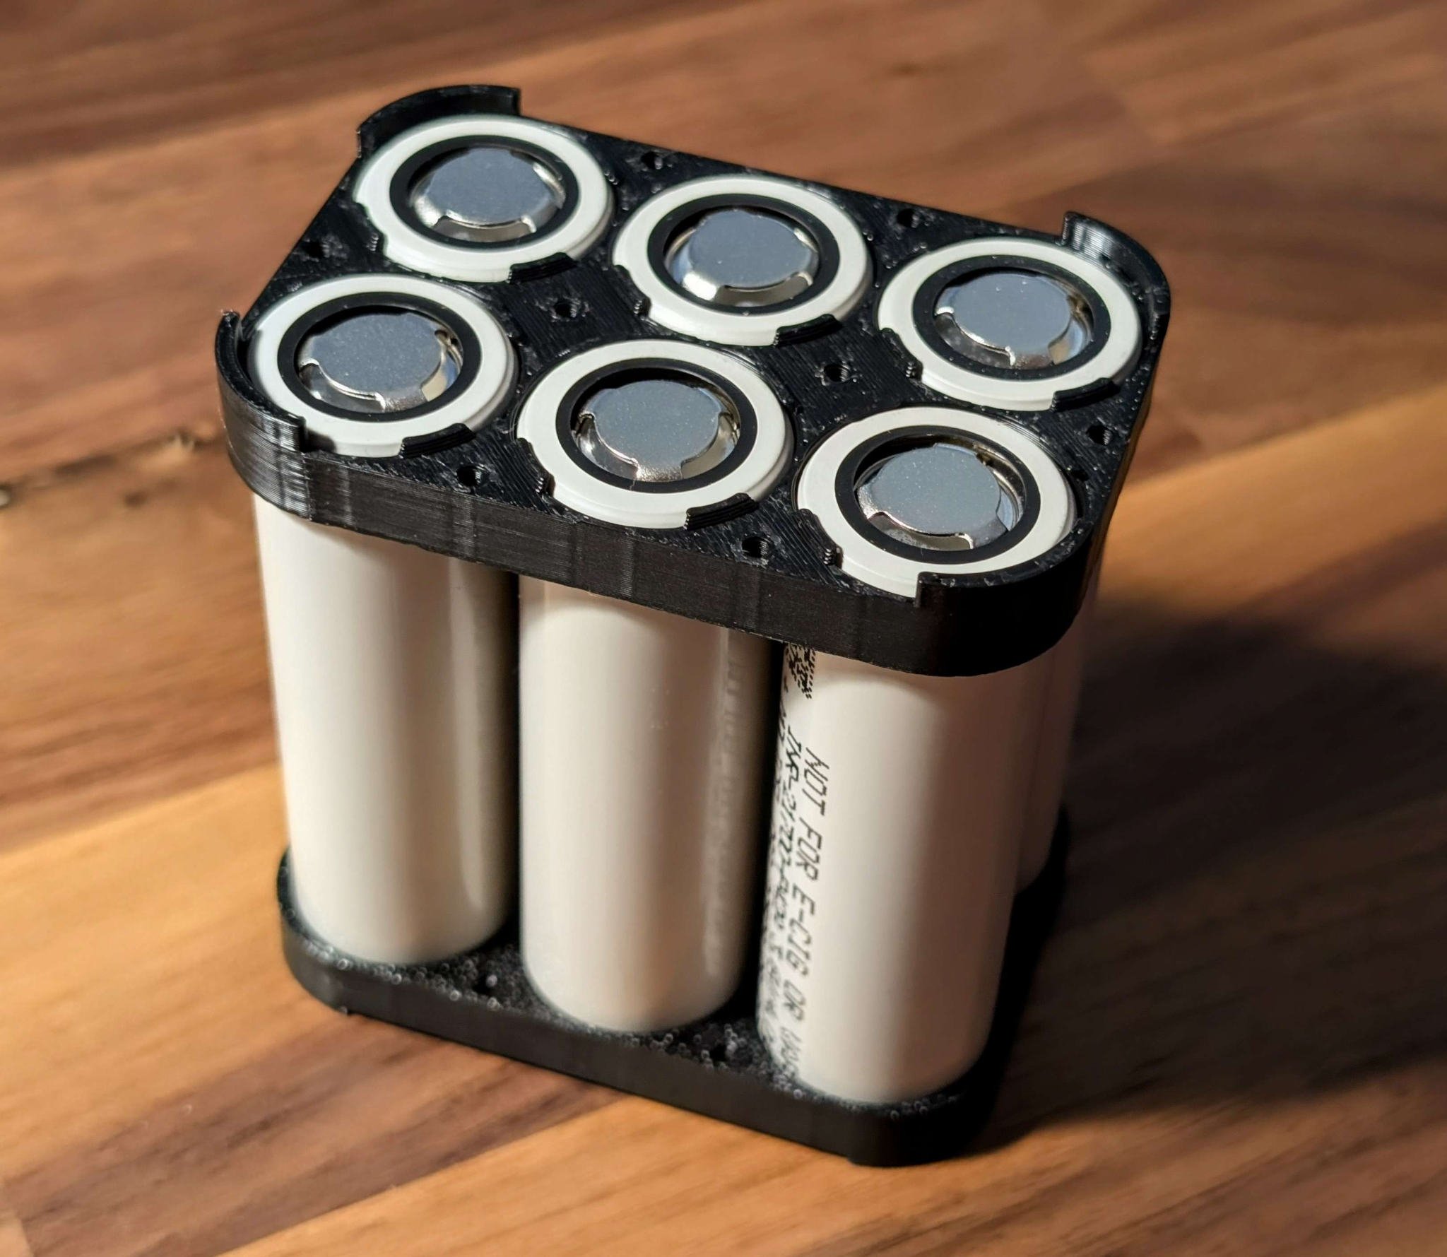
Prototype IV - Movement System
Prototype V- BMS & Power Delivery

Slide 25
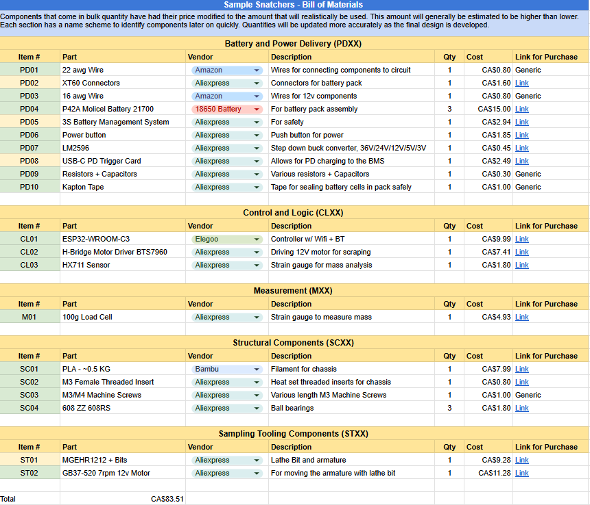
Bill of Materials (BOM)

Slide 26
Thank you for listening to our TED Talk!

